Slide 1
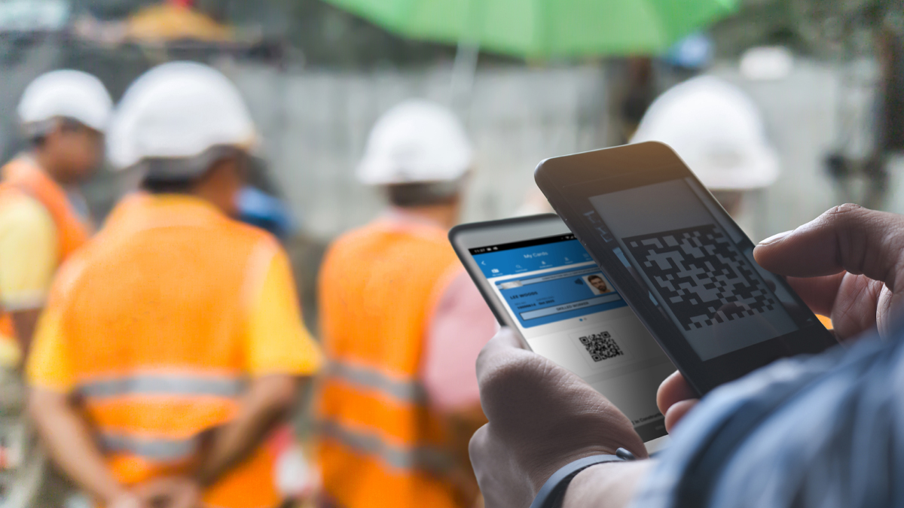
Webinar 1: 10th March 2022
Notes:
Welcome & introductions
Alan introduced the project team
Highlight that Build UK will be familiar with some of the content – but want to demonstrate what the rest of the industry will see/hear until we are in a position to deliver live demos
Today is about, background, functionality, what Build UK members should expect in April and how we intend to roll it out.

Slide 2
Raising standards in construction
The One Industry Logo Initiative
At the beginning of 2015 the Construction Leadership Council (CLC) announced via the Industrial Strategy: Construction 2025, that industry, including trade associations, contractors, clients and government, should specify and promote card schemes displaying the CSCS logo with no equivalents accepted. This is known as the One Industry Logo action.

Slide 3
Raising standards in construction
CLC Requirements
The CLC listed a number of requirements with the main one being:
Agreeing appropriate qualifications for each occupation
Setting a minimum standard for skilled occupations at NVQ Level 2
Removal of Industry Accreditation
The implementation of smart technology using a common interface by 31st March 2022.
Notes:
Importance of card checks – expand on bullet points
Existing card checking procedures – expand on the various techs available through to those with no tech
Expand on the complexities and incompatibility
Expand on the issues/risks as per bullet points

Slide 4
Common Interface
Raising standards in construction
“By 31 March 2022, all card schemes must use smart technology which has the capability to electronically check agreed information relevant to a cardholder, using a common interface, without the need to manually enter data.“
Aims:
Increased use of technology
Ensure all cards are genuine & in date
Workers hold the appropriate training and qualifications
Results:
Improved standards, productivity and safety
Notes:
Importance of card checks – expand on bullet points
Existing card checking procedures – expand on the various techs available through to those with no tech
Expand on the complexities and incompatibility
Expand on the issues/risks as per bullet points

Slide 5
Raising standards in construction
Notes:
A visual demonstrating the complexity of the current card checking landscape and the size of the challenge for the Alliance.

Slide 6
Raising standards in construction
The app is called CSCS Smart Check, and it is free
A card checking app for those responsible for checking cards on site
Not an app for individuals to store details of their cards, e.g. My CSCS, MyECS or Smart PAL
Cards that are not smart will have the option of using a manual entry check
Does not store info about the card or card holder – simply checks that the card is valid and displays info printed on the card
Available from 1st April: download from the Apple Store or Google Play Store

Slide 7
Removal of Industry Accreditation
What does this mean for IA card holders?
All IA cards renewed from 1st January 2020 have a fixed expiry date and will expire on 31st December 2024 and will not be renewed
CSCS will cease renewing IA cards from 30th June 2024
Next Steps
CSCS are working with Standard Setting Body to review the qualification delivery methods
Notes:
Run through of key deliverables from the Comms Strategy
Expand on the priority actions as per bullet points.

Slide 8
Communications
Strategy:
Raise awareness
Direct engagement
Timeline:
Up to April 2022
Beyond April 2022
Priorities:
Preparing the industry
Supporting materials
Initially stand-alone - period of transition
Continued promotion - encourage uptake
Notes:
Run through of key deliverables from the Comms Strategy
Expand on the priority actions as per bullet points.

Slide 9
Questions?

